Slide 1

WELCOME TO
NETAJI SUBHAS INSTITUTE OF TECHNOLOGY
AMHARA, BIHTA, PATNA - 801106
Presented By :-
Sachin Kumar
Md Asif
Aman kumar
Faizal Ahmad

Slide 2


DIGITAL INDIA
Growth is Good

Slide 3

CONTENTS
01
02
03
What is Digital India
Digital Public Infrastructure
Aadhar + e-kyc Digital Indentity layer
04
05
06
IT for Jobs
Technology Strack Behind Digital India
Digital India In Rural Area

Slide 4
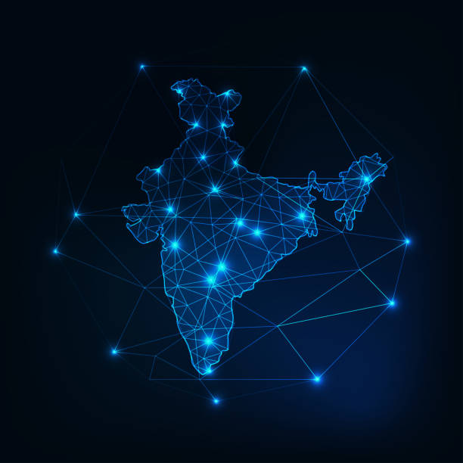
01 What is Digital India
FALGSHIP:- Government of india programme launched
        on 1 july 2015
Vision :- Transform India int a Digitally empowered society
      and knowledge economy
FOCUS :- Digital infrastructure, Services on demand and citizen empowernment
KET IDEA :- Build interoperable Digital system that can scale notionally .

Slide 5

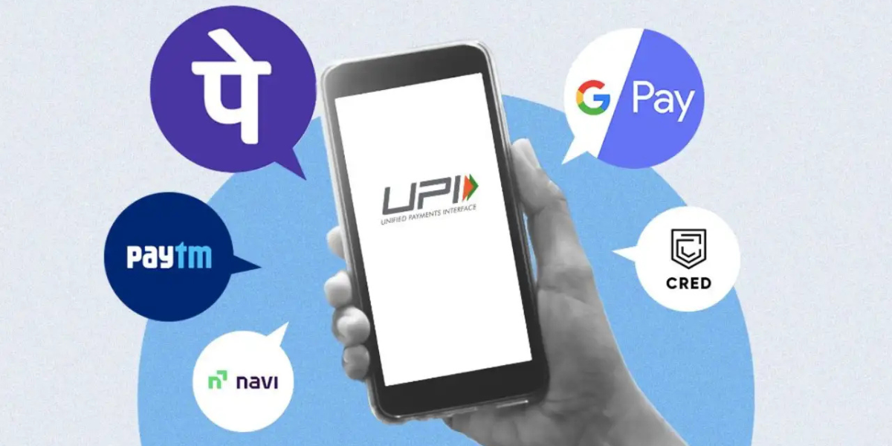
02 Digital Public Infrastructure
DigiLocker : - Cloud-based platform for issuing, storing,
and verifying official documents and certificates.
Open Network for Digital Commerce (ONDC) : -
Open protocol network designed to democratize e-commerce.
Unified Payments Interface (UPI) :- Real-time, interoperable
payment system handling billions of monthly transactions.
Aadhaar Authentication:- Provides secure eKYC and paperless identity verification across telecom, banking, and welfare services.

Slide 6

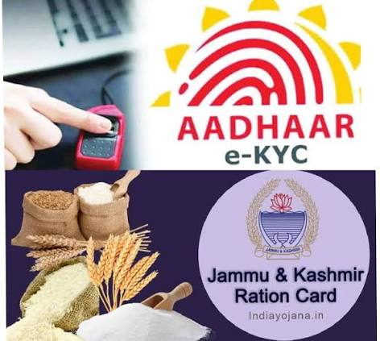
03 Aadhar + e-kyc Digital Indentity layer
How It Works
You provide your 12-digit Aadhaar number and give formal consent to share your data.
The service provider securely connects to the UIDAI database for verification.
Verification happens using a One-Time Password (OTP) sent to your mobile number or via biometric scans (fingerprint or iris).
UIDAI shares basic demographic details—such as your name, address, date of birth, gender, and photograph—with the authorized institution.
r

Slide 7
04 DigiLocker &Paperless Governance
Digital repository and sharing platform for authentic documents.
Can reduce physical paperwork and verification friction.
Useful examples: educational certificates, driving licence and other issued records. I
nteroperability lets institutions verify documentsdigitaly where supported.

Slide 8
05 Digital India In Education & Rural Inclusion
Online learning and digital content expand access beyond physical classrooms.
Digital public services can reduce travel and paperwork for citizens.
Rural inclusion depends on connectivity, affordable devices, local-language content and digital literacy.
Accessibility and assisted digital services remain important for citizens who need support..

Slide 9

THANK YOU
“ Digital India is not Just a Programme ,
It is vision for a Stronger India”

